Slide 1
Examination Record Management System

Slide 2
Group B
Members
Vann Neight Thawng
Myat Noe Thar
Min Htet Aung
Hein Htet Thura
Tin May Khaing
Htet Hsu Naychi
Lwin Thandar Aung

Slide 3
Outline
Introduction to our project
Objective
Flow charts of exam record system in university
Flow charts of our project
ER diagram
Pros and Cons
Future Plan

Slide 4
Introduction to our project
Our system is the examination record management system.
It helps you to manage the exam record easier and faster ,executing the project.
In this project ,this includes three sessions which go into detail from data inserting to producing final results.
Three sessions consist of
1.Inserting marks
2.Viewing marks
3.Creation of new data.

Slide 5
Languages and Application used
Languages
J2SE
SQL
IDE
Eclipse
mySQL

Slide 6
Objective
To make easier in examination record management
To reduce time consumption for staff in student affair
To have a better performance for the examination record system
To reduce paper work

Slide 7
Marking System
Semester
Exam
Marks>=50
No
Fail
Yes
ReExam
Yes
Marks>=85
Yes
Excellence
Marks<50
Fail
No
No
Pass

Slide 8
Examination System
1st Semester Exam
&&
2nd Semester Exam
Current Course
Pass
No
Yes
Fail Current Course
Pass Current Course
Two Semester’s total marks
New Course

Slide 9
Start
Login
User Level
Admin
Level
Staff
Choose Option
Results
Approve
User account request
Exam Marks Insertion
Create New
Exam Marks
Results
Database
- Student Data
Marks
Major
Academic
Subject
Retrieve Data
Fig: Flow Chart of our project

Slide 10
Major
Student
Major-ID
1
Major _ID
Major
1
Major-ID
M
Major _ID
Student _ID
Student _Name
User
1
User _ID
User _name
User _Level
1
M
Student-ID
Subject
Major _ID
Subject _code
Subject _Name
Course
Semester
Major _ID
M
unconfirmed
Student _Roll No
User _ID
User _name
password
1
Roll _No
Student _ID
Academic _ID
1
M
Marks
M
Subject _code
Tutorial
Exam
Practical
Total
Re Exam
Subject _Code
Academic _ID
Roll _No
Major _ID
M
Academic-ID
Roll _N0
M
1
M
Academic-ID
1
Academic
Academic _ID
Academic
ER diagram of examination record management system

Slide 11
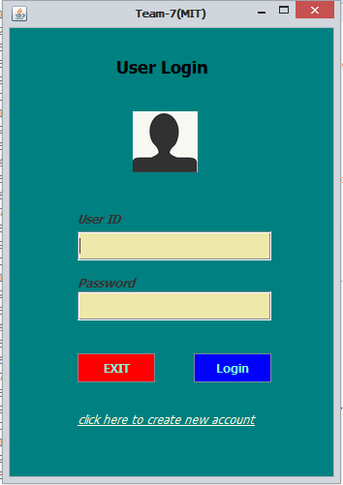
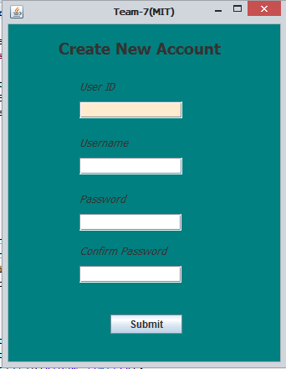
LOGIN PAGE
SIGN UP PAGE

Slide 12

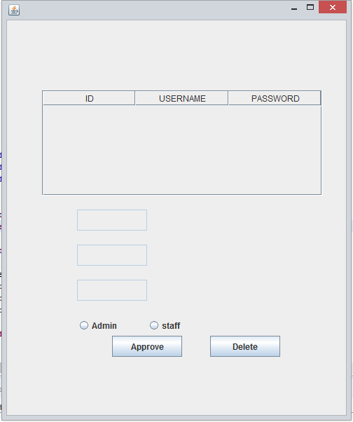
ADMIN PAGE
HOME PAGE

Slide 13
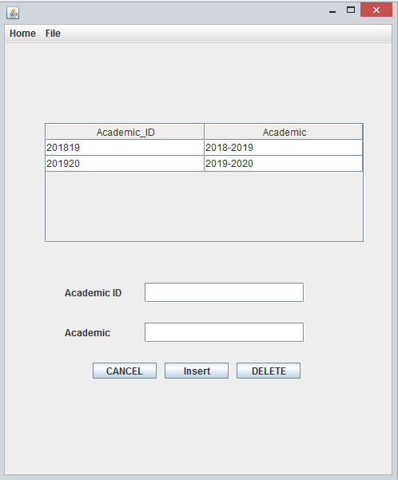
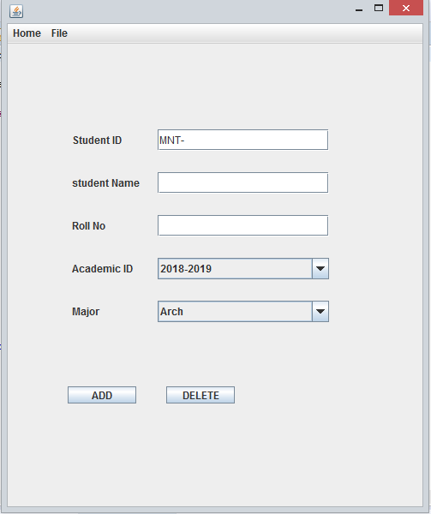
ACADEMIC CREATING PAGE
STUDENT CREATING PAGE

Slide 14
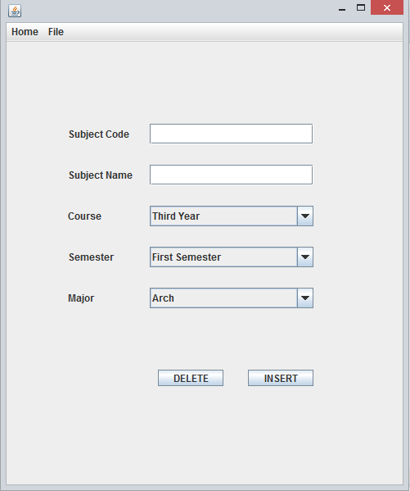
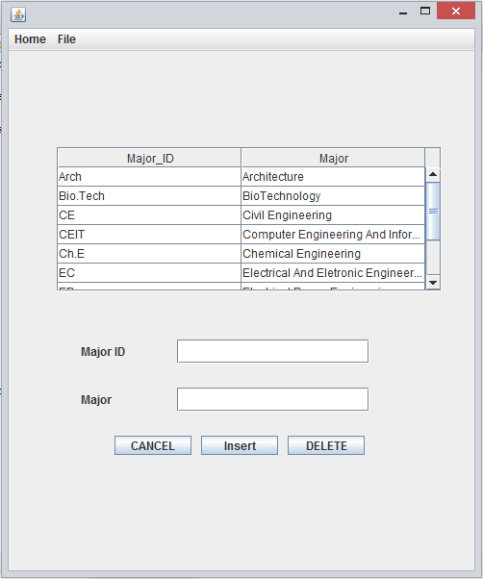
SUBJECT CREATING PAGE
DEPARTMENT CREATING PAGE

Slide 15
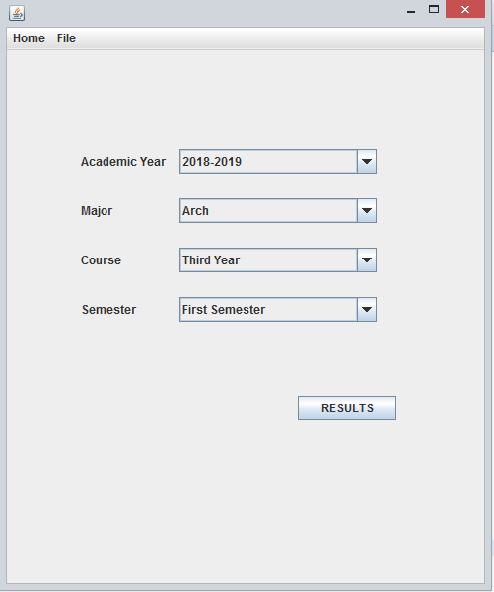
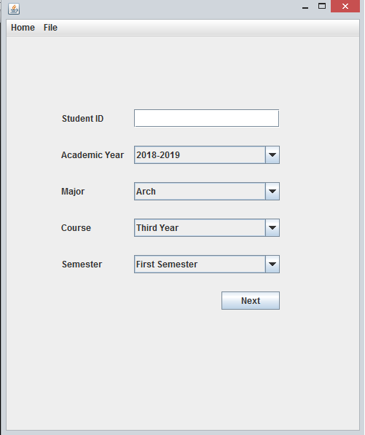
MARKS INSERT AND VIEW FORM
MARKS VIEW FORM FOR STUDENT

Slide 16
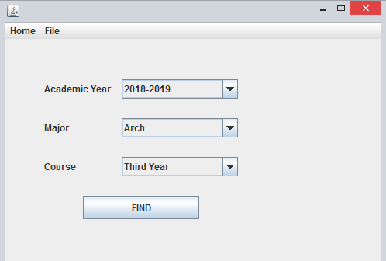
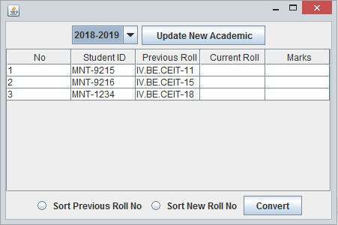
FORM DESIGN FOR UPDATING ROLL NUMBERS FOR NEW ACADEMIC

Slide 17
Pros And Cons
Pros
Much faster and easier in managing examination records .
Reduce time cost and paper work.
As only one person is enough to use this project , we can reduce man-power.
Cons
Our project is not still complete .
It is not user friendly now.
And it is not compactable with the schema we used now in our exam systems.

Slide 18
Future Plan
Later, we can able to manage about credit marks of each subject.
Also students can be able to view their marks by using our project.
And then we are willing to print exam result forms for students.
We have also a plan to add necessary data asked by teachers.
Although our system is not a complete system and not user friendly ,we will update our project to complete.

Slide 19
Thank You!

